Slide 1


Contractual interpretation under English and Continental law:
Much more similar than you might think!

Slide 2

Bernese Commentary

Slide 3
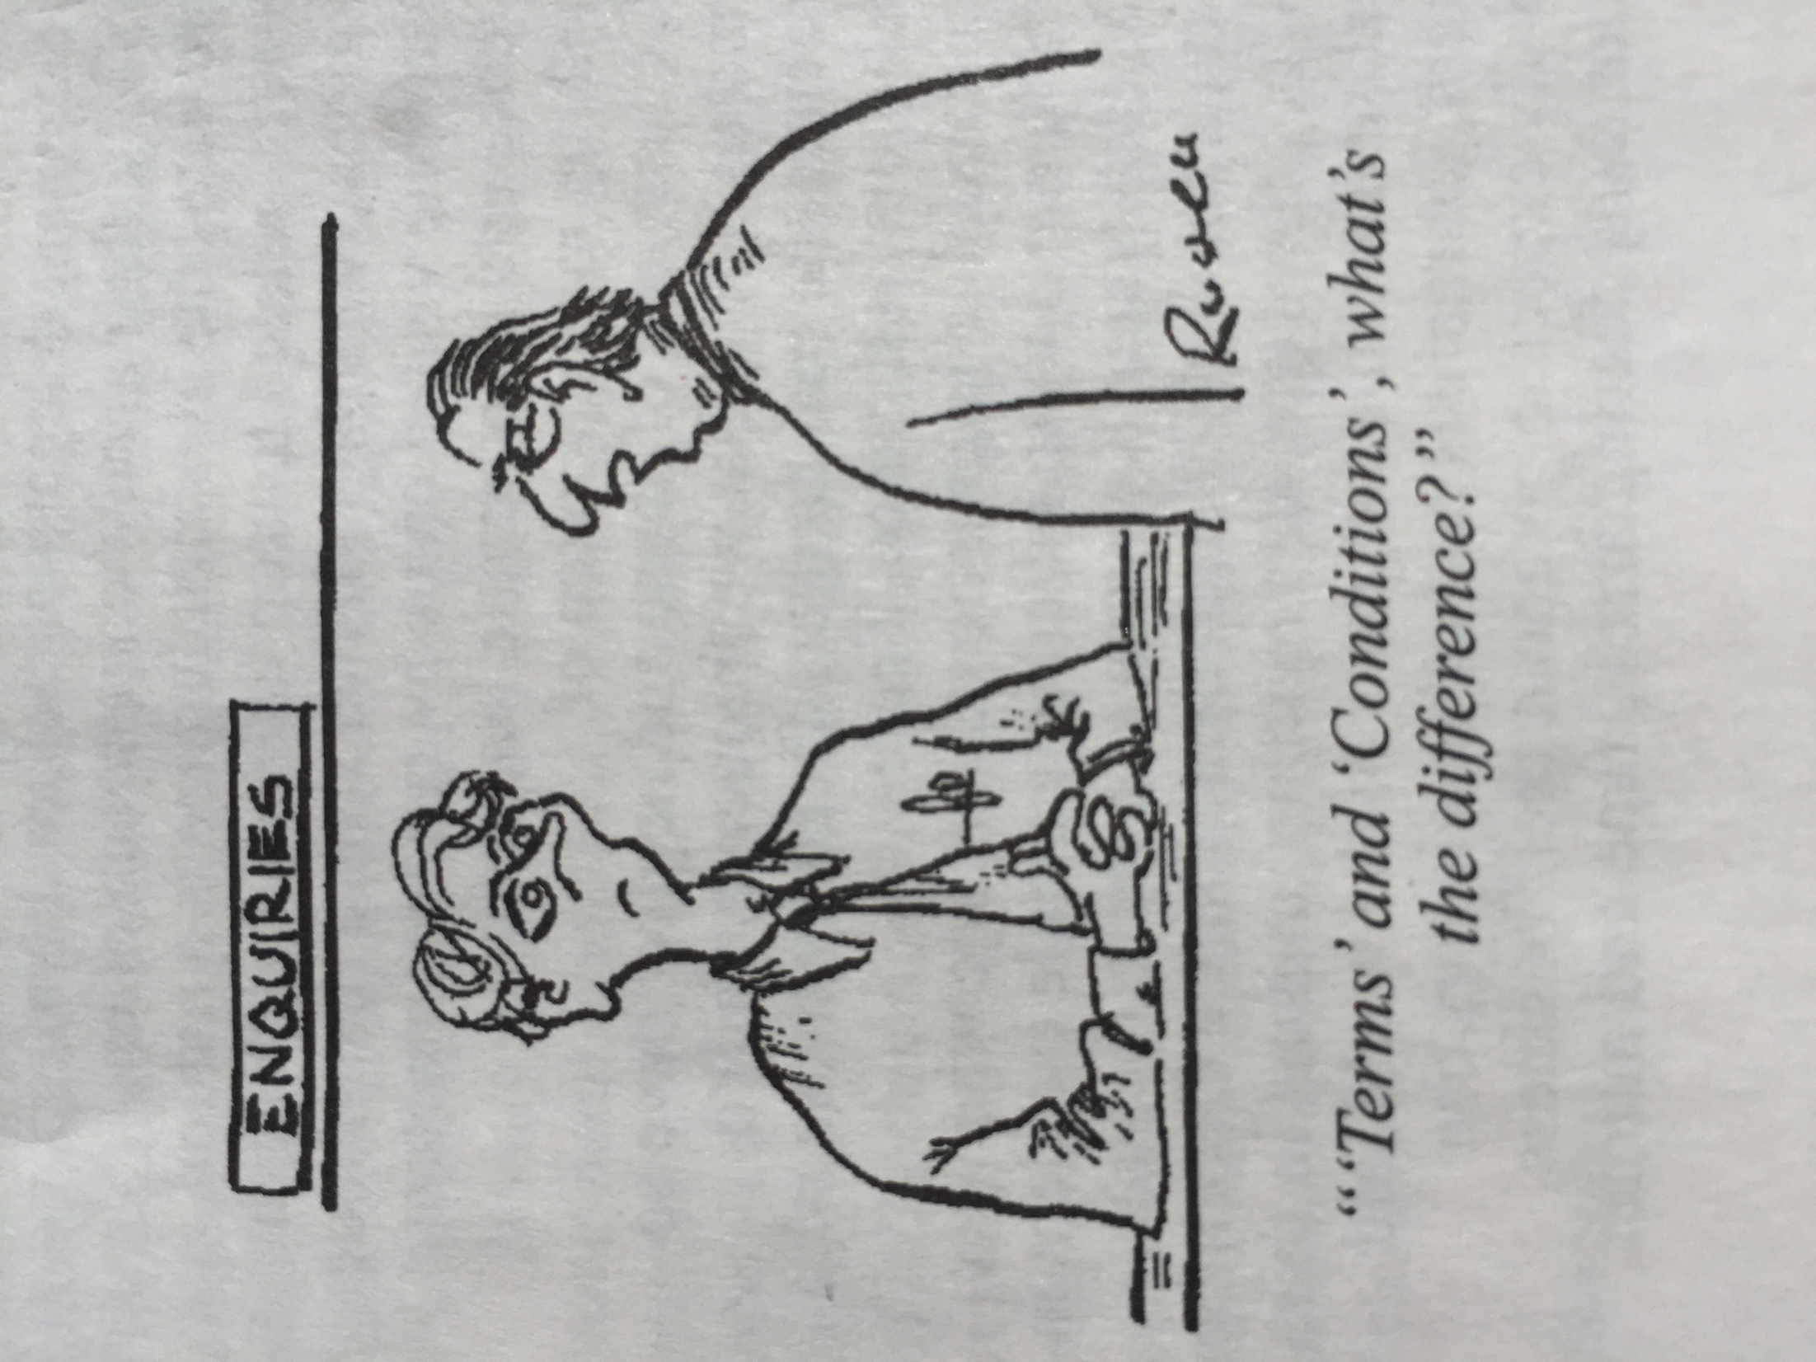
‘Terms’ and ‘conditions’?

Slide 4
Contractual Interpretation under English and Continental Law:
Much more similar than you might think!

Slide 5
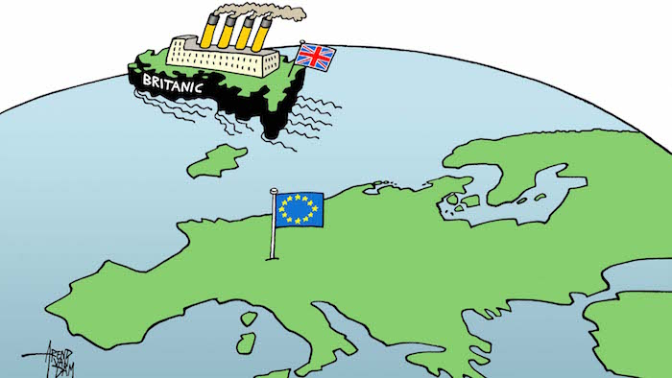

Slide 6
18 SCO
“Interpretation of contracts; simulation
(1) When assessing the form and terms of a contract, the true and common intention of the parties must be ascertained without dwelling on any inexact expressions or designations they may have used either in error or by way of disguising the true nature of the agreement.”

Slide 7
Objective v Subjective Approach

Slide 8
Smith v Hughes (1871) LR 6 QB 597, 607
“If, whatever a man’s real intention may be, he so conducts himself that a reasonable man would believe that he was assenting to the terms proposed by the other party, and that other party upon that belief enters into the contract with him, the man thus conducting himself would be equally bound as if he had intended to agree to the other party’s terms.”

Slide 9
Investors Compensation Scheme Ltd. v West Bromwich Building Society [1997] UKHL 28 per Lord HoffmanN
“Interpretation is the ascertainment of meaning which the document would convey to a reasonable person having all the background knowledge which would reasonably have been available to the parties in the situation in which they were at the time of the contract.”

Slide 10
Marley v Rawlings & Anor [2014] UKSC 2, 19 per Lord Neuberger
“When interpreting a contract, the court is concerned to find the intention of the party or parties, and it does this by identifying the meaning of the relevant words, (a) in the light of (i) the natural and ordinary meaning of those words, (ii) the overall purpose of the document, (iii) any other provisions of the document, (iv) the facts known or assumed by the parties at the time that the document was executed, and (v) common sense, but (b) ignoring subjective evidence of any party’s intentions.”

Slide 11
18(1) sCO
“When assessing the form and terms of a contract, the true and common intention of the parties must be ascertained without dwelling on any inexact expressions or designations they may have used either in error or by way of disguising the true nature of the agreement.”
“Bei der Beurteilung eines Vertrages sowohl nach Form als nach Inhalt ist der übereinstimmende wirkliche Wille und nicht die unrichtige Bezeichnung oder Ausdrucksweise zu beachten, die von den Parteien aus Irrtum oder in der Absicht gebraucht wird, die wahre Beschaffenheit des Vertrages zu verbergen.”
“Pour apprécier la forme et les clauses d'un contrat, il y a lieu de rechercher la réelle et commune intention des parties, sans s'arrêter aux expressions ou dénominations inexactes dont elles ont pu se servir, soit par erreur, soit pour déguiser la nature véritable de la convention.”

Slide 12
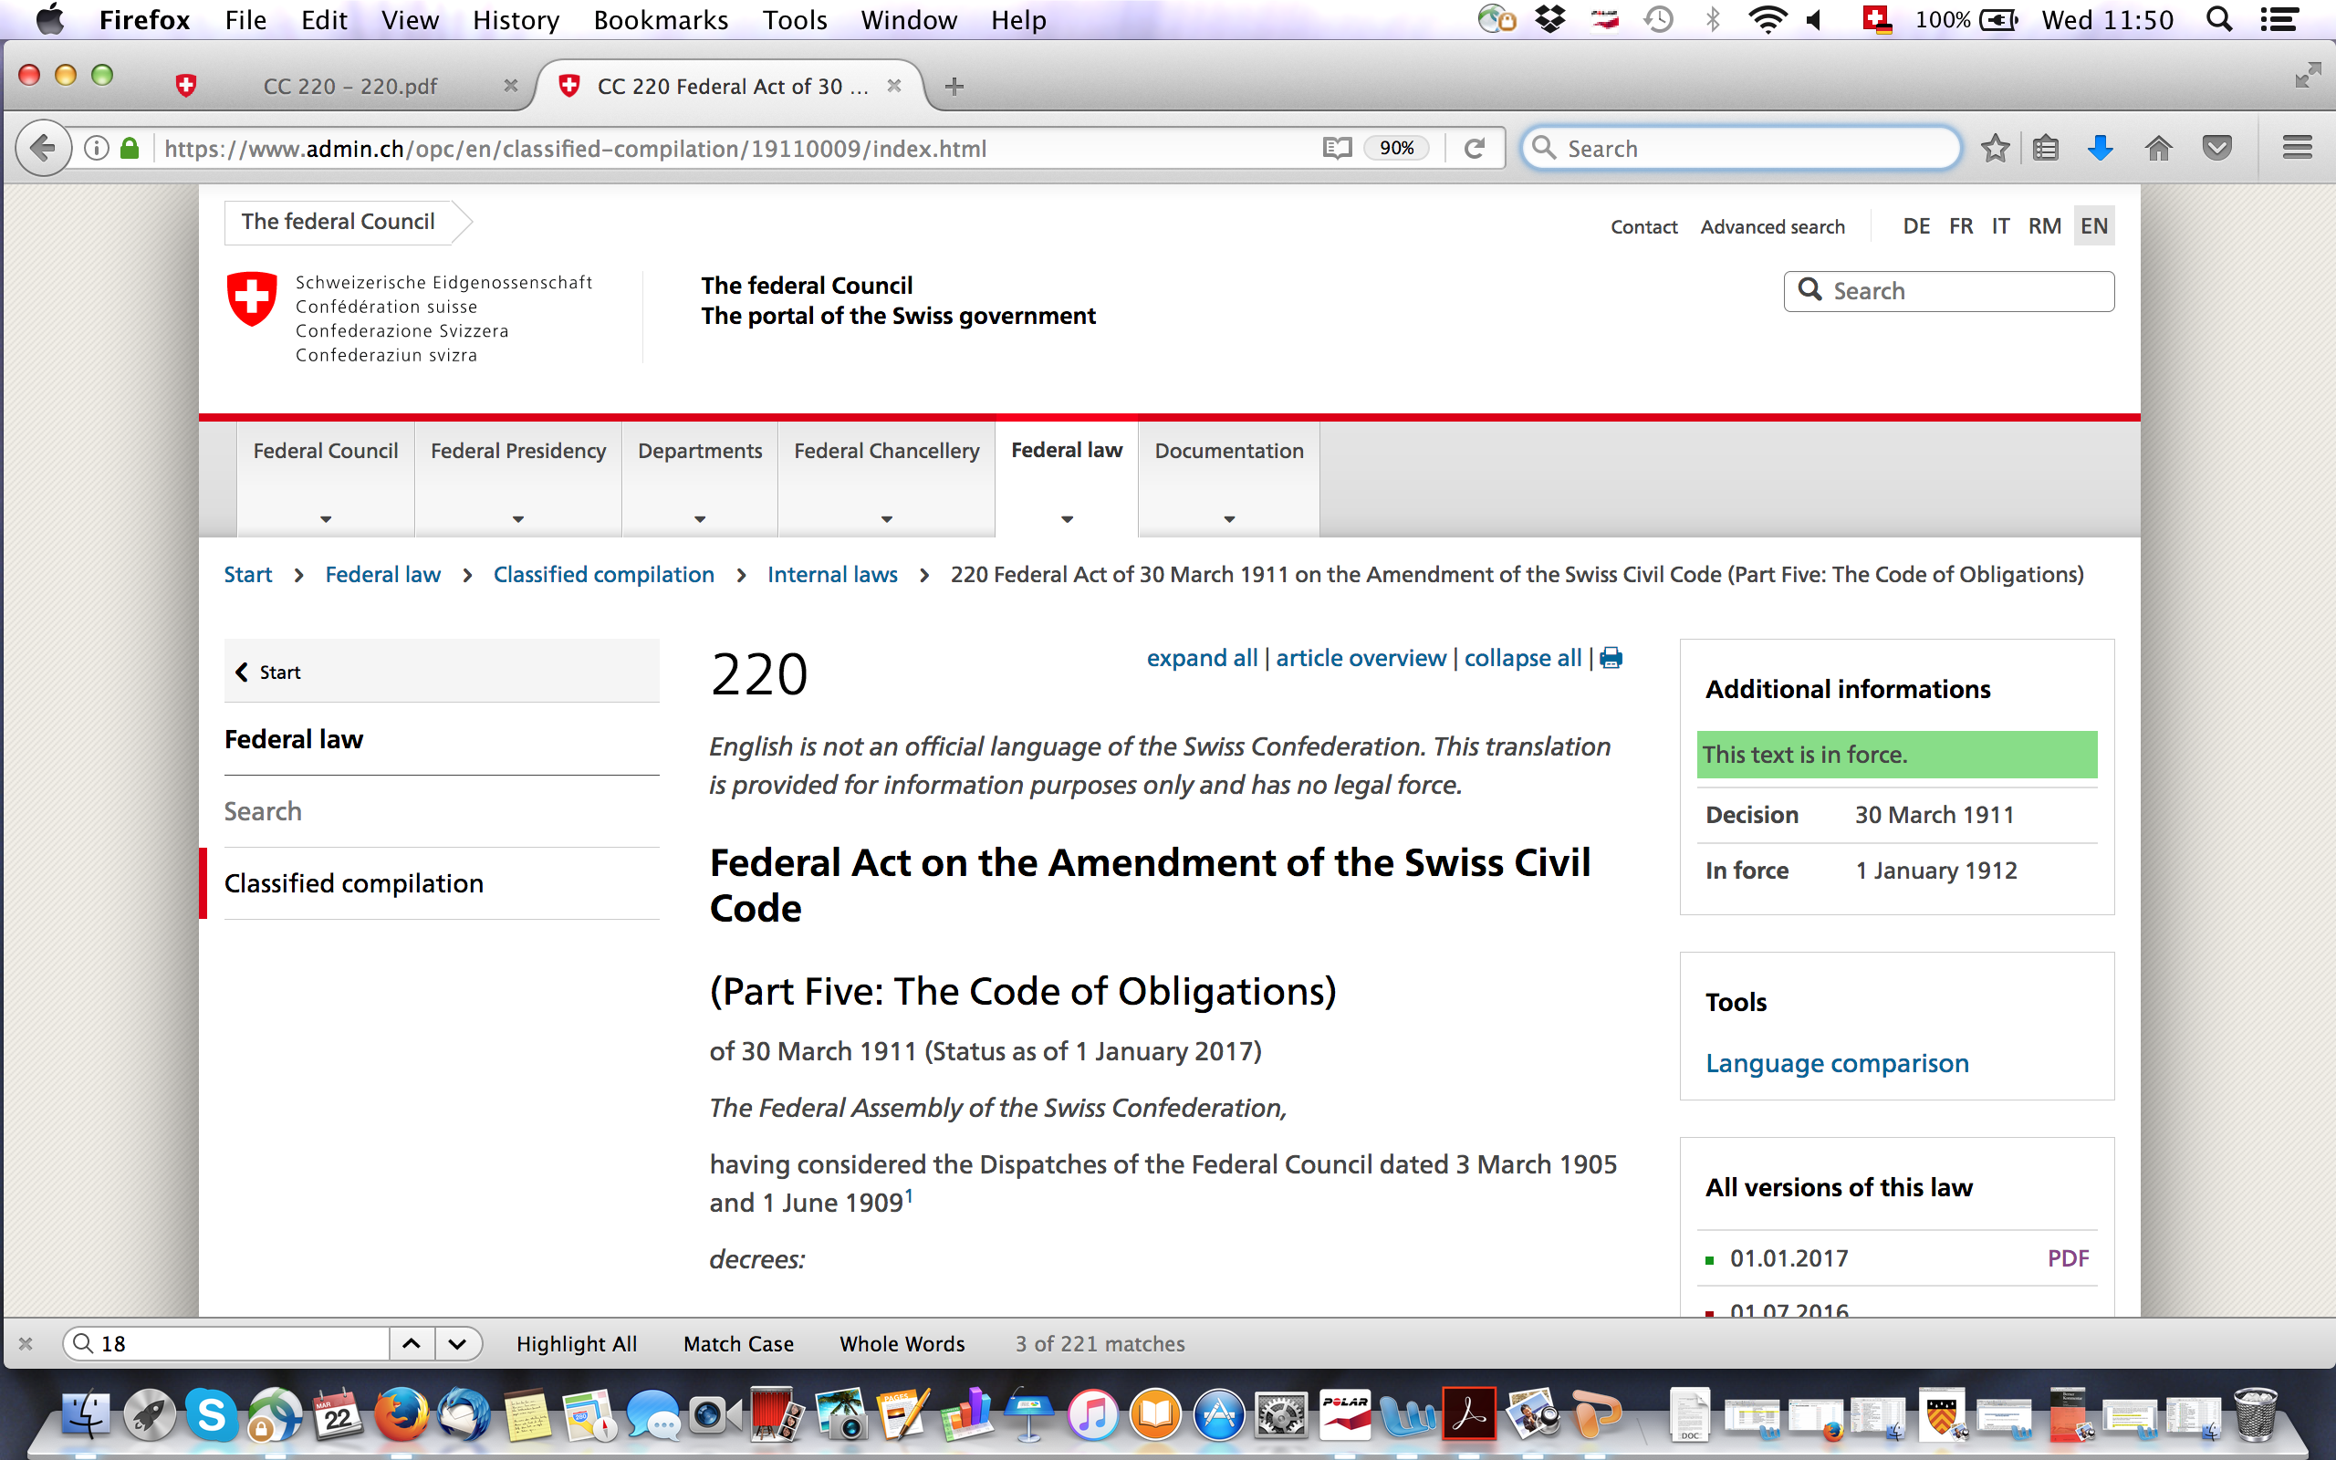
Website of the swiss government

Slide 13
DSFC 142 III 239 c. 5.2.1, 253
“Under Swiss law, (…) the judge, the arbitrator or the arbitral tribunal first strives at bringing to light the parties’ actual and common intention (“la réelle et commune intention des parties”) (cf. Art. 18 I CO), as the case may be empirically, based on indications, without dwelling on any inexact expressions or designations they may have used. Not only the wording of the manifestations of will, but the general context, be it the declarations made before entering into the contract, draft contracts, exchanged correspondence or even the parties’ behaviour after the conclusion of the contract, are among such indications. This subjective interpretation is based on an assessment of the evidence. If this assessment is conclusive, the result to which it leads, i.e. the ascertainment of the parties’ actual and common intention is a factual issue to which the Supreme Court is bound”

Slide 14
1188(1) FCC - 1362 ICC - 133 BGB - 914 ABGB
Art. 1188(1) French Civil Code: “Le contrat s’interprète d’après la commune intention des parties plutôt qu’en s’arrêtant au sens littéral de ses termes.”
Art. 1362 Italian Civil Code: “Nel interpretare il contratto si deve indagare quale sia stata la comune intenzione delle parti e non limitarsi al senso letterale delle parole.”
§ 133 German Civil Code (Auslegung einer Willenserklärung): “Bei der Auslegung einer Willenserklärung ist der wirkliche Willen zu erforschen und nicht an dem buchstäblichen Sinne des Ausdrucks zu haften.”
§ 914 Austrian Civil Code: “Bei Auslegung von Verträgen ist nicht an dem buchstäblichen Sinne des Ausdrucks zu haften, sondern die Absicht der Parteien zu erforschen und der Vertrag so zu verstehen, wie es der Übung des redlichen Verkehrs entspricht.”

Slide 15
Papinian, Digest 50.16.219
“In conventionibus contrahentium voluntatem potius quam verba spectari placuit.”

Slide 16
1188(2) FCC - 1366 ICC - 157 BGB - 914 ABGB
Art. 1188(2) French Civile Code: “Lorsque cette intention ne peut être décelée, le contrat s’interprète selon le sens que lui donnerait une personne raisonnable placée dans la même situation.”
Art. 1366 Italian Civil Code: “Il contratto deve essere interpretato secondo buona fede.”
§ 157 German Civil Code (Auslegung von Verträgen): “Verträge sind so auszulegen, wie Treu und Glauben mit Rücksicht auf die Verkehrssitte es erfordern.”
§ 914 Austrian Civil Code: “Bei Auslegung von Verträgen ist nicht an dem buchstäblichen Sinne des Ausdrucks zu haften, sondern die Absicht der Parteien zu erforschen und der Vertrag so zu verstehen, wie es der Übung des redlichen Verkehrs entspricht.”

Slide 17
8 CISG
“(1) For the purposes of this Convention statements made by and other conduct of a party are to be interpreted according to his intent where the other party knew or could not have been unaware what that intent was.
(2) If the preceding paragraph is not applicable, statements made by and other conduct of a party are to be interpreted according to the understanding that a reasonable person of the same kind as the other party would have had in the same circumstances.
(3) In determining the intent of a party or the understanding a reasonable person would have had, due consideration is to be given to all relevant circumstances of the case including the negotiations, any practices which the parties have established between themselves, usages and any subsequent conduct of the parties.”

Slide 18
5:101 PECL
“(1) A contract is to be interpreted according to the common intention of the parties even if this differs from the literal meaning of the words.
(2) If it is established that one party intended the contract to have a particular meaning, and at the time of the conclusion of the contract the other party could not have been unaware of the first party's intention, the contract is to be interpreted in the way intended by the first party.
(3) If an intention cannot be established according to (1) or (2), the contract is to be interpreted according to the meaning that reasonable persons of the same kind as the parties would give to it in the same circumstances.”

Slide 19
II.-8.101 DCFR
“(1) A contract is to be interpreted according to the common intention of the parties even if this differs from the literal meaning of the words.
(2) If one party intended the contract, or a term or expression used in it, to have a particular meaning, and at the time of the conclusion of the contract the other party was aware, or could reasonably be expected to have been aware, of the first party’s intention, the contract is to be interpreted in the way intended by the first party.
(3) The contract is, however, to be interpreted according to the meaning which a reasonable person would give to it:
if an intention cannot be established under the preceding paragraphs; or
if the question arises with a person, not being a party to the contract or a person who by law has no better rights than such a party, who has reasonably and in good faith relied on the contract’s apparent meaning.”

Slide 20
4.1 PICC
“(1) A contract shall be interpreted according to the common intention of the parties.
(2) If such an intention cannot be established, the contract shall be interpreted according to the meaning that reasonable persons of the same kind as the parties would give to it in the same circumstances.”

Slide 21
58 CESL
“(1) A contract is to be interpreted according to the common intention of the parties even if this differs from the normal meaning of the expressions used in it.
(2) Where one party intended an expression used in the contract to have a particular meaning, and at the time of the conclusion of the contract the other party was aware, or could be expected to have been aware, of that intention, the expression is to be interpreted in the way intended by the first party.
(3) Unless otherwise provided in paragraphs 1 and 2, the contract is to be interpreted according to the meaning which a reasonable person would give to it.”

Slide 22
Pre-Contractual Negotiation Evidence Bar

Slide 23
Chartbrook Ltd v Persimmon Homes Ltd (2009) UKHL 38, 41 per Lord HoffmanN
“The rule may well mean (…) that parties are sometimes held bound by a contract in terms which, upon a full investigation of the course of negotiations, a reasonable observer would not have taken them to have intended. But a system which sometimes allows this to happen may be justified in the more general interest of economy and predictability in obtaining advice and adjudicating disputes. It is, after all, usually possible to avoid surprises by carefully reading the documents before signing them and there are the safety nets of rectification and estoppel by convention”.

Slide 24
Chartbrook Ltd v Persimmon Homes Ltd (2009) UKHL 38, 41 per Lord Hoffmann
“(t)here are no particular pressing circumstances which call for a change. The House is simply being asked to make a fresh policy decision and, in effect, to legislate to provide for a different rule. The wisdom of the proposed change is, however, debatable. So, if there is to be a change, it should be on the basis of a fully informed debate in a forum where the competing policies can be properly investigated and evaluated. ”

Slide 25
5 reasons
Avoidance of uncertainty and unpredictability.
Interested third parties cannot be guaranteed access to such negotiation history.
Contract negotiations are notoriously shifting and so such evidence would be unhelpful.
One-sided impressions might contaminate the inquiry.
Sophisticated and knowledgeable negotiators would be tempted to lay a paper trail of self-serving documents.

Slide 26
8(3) CISG - 4.3(a) PICC
Art. 8(3) CISG: “In determining the intent of a party or the understanding a reasonable person would have had, due consideration is to be given to all relevant circumstances of the case including the negotiations, any practices which the parties have established between themselves, usages and any subsequent conduct of the parties.”
Art. 4.3(a) PICC: “In applying Articles 4.1 and 4.2, regard shall be had to all circumstances, including (a) preliminary negotiations between the parties.”

Slide 27
5:102 PECL – II.-8:102 DCFR
Art. 5:102 PECL:
“In interpreting the contract, regard shall be had, in particular, to:
(a) the circumstances in which it was concluded, including the preliminary negotiations;
(b) the conduct of the parties, even subsequent to the conclusion of the contract;
(g) good faith and fair dealing.”
Art. II.-8:102 DCFR:
“(1) In interpreting the contract, regard may be had, in particular, to:
(a) the circumstances in which it was concluded, including the preliminary negotiations;
(b) the conduct of the parties, even subsequent to the conclusion of the contract;
(g) good faith and fair dealing.”

Slide 28
59 CESL
“In interpreting a contract, regard may be had, in particular, to:
(a) the circumstances in which it was concluded, including the preliminary negotiations;
(b) the conduct of the parties, even subsequent to the conclusion of the contract;
(c) the interpretation which has already been given by the parties to expressions which are identical to or similar to those used in the contract;
(d) usages which would be considered generally applicable by parties in the same situation;
(e) practices which the parties have established between themselves;
(f) the meaning commonly given to expressions in the branch of activity concerned;
(g) the nature and purpose of the contract; and
(h) good faith and fair dealing.”

Slide 29
Restatement 2nd of Contracts, § 214
“Agreements and negotiations prior to or contemporaneous with the adoption of a writing are admissible in evidence to establish (a) that the writing is or is not an integrated agreement; (…) (c) the meaning of the writing, whether or not integrated. ”

Slide 30
32 Vienna Convention on the Law of Treaties
“Recourse may be had to supplementary means of interpretation, including the preparatory work of the treaty and the circumstances of its conclusion, in order to confirm the meaning resulting from the application of article 31, or to determine the meaning when the interpretation according to article 31 :
Leaves the meaning ambiguous or obscure; or
Leads to a result which is manifestly absurd or unreasonable.”

Slide 31
3 exceptions
special meaning exception
(2) estoppel by convention exception
(3) rectification exception

Slide 32
David McLauchlan, The entire agreement clause: conclusive or a question of weight? (2012) 128 LQR 521, 531
“A writing has no magical power to cause statements of fact to be true when they are actually untrue.”

Slide 33
Concluding Remarks

Slide 34
Claimant:
Mother Company (Saudi Arabia)
Claim
Assignment of contract
Affiliate Company (Netherlands)
Contract
Respondent:
Company
(Germany)
Arbitration clause

Slide 35
Thank you for your attention
Prof. Christoph Müller
Attorney-at-law, LL.M. (Columbia Law School)
Avenue du 1er-Mars 26
CH-2000 Neuchâtel
christoph.mueller@unine.ch
www.unine.ch
From August 2016 to July 2017:
Clare Hall College
Herschel Road
Cambridge
CB3 9AL
United Kingdom

